Slide 1
UNDERSTANDING THE EVOLUTION OF BACTERIA WITH MACHINE LEARNING
Computer Science Department
Naman Kanwar and Harnoor Singh
Advisor: Daniel Pimentel

Slide 2
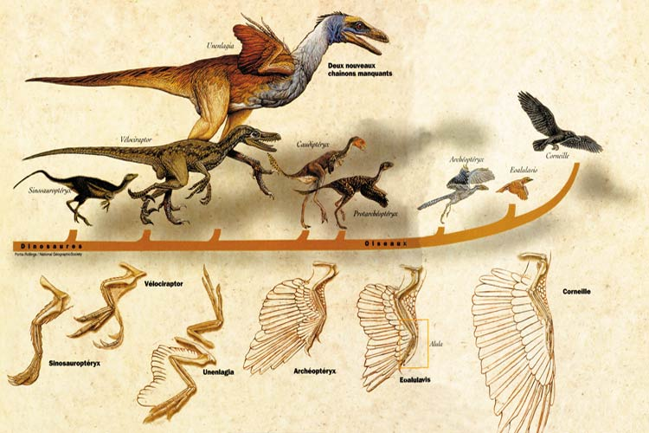
Evolution

Slide 3
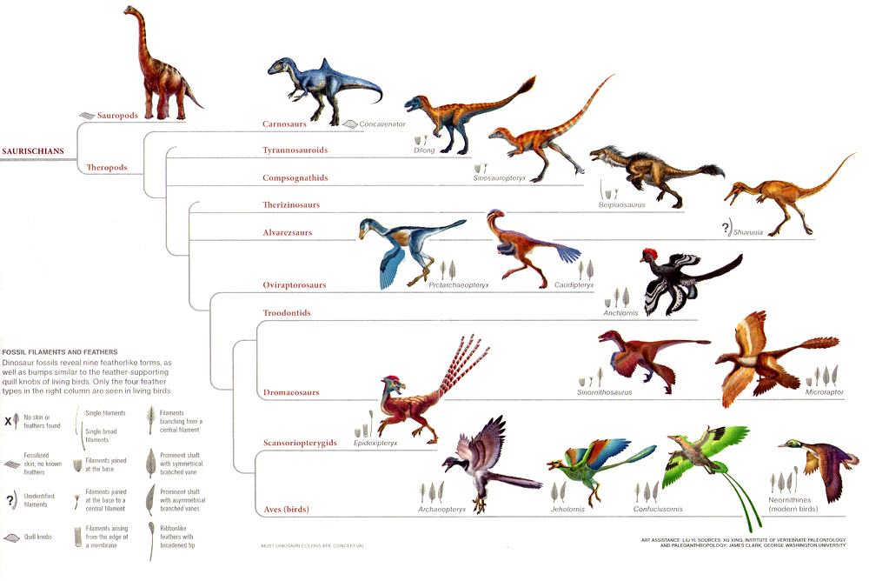
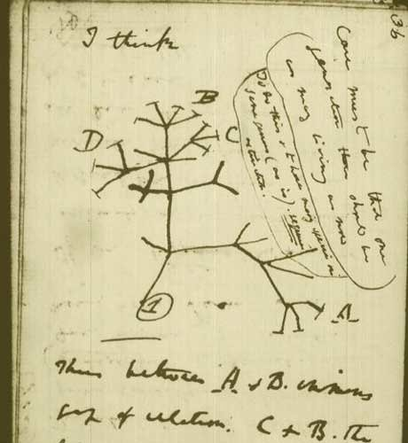

Slide 4
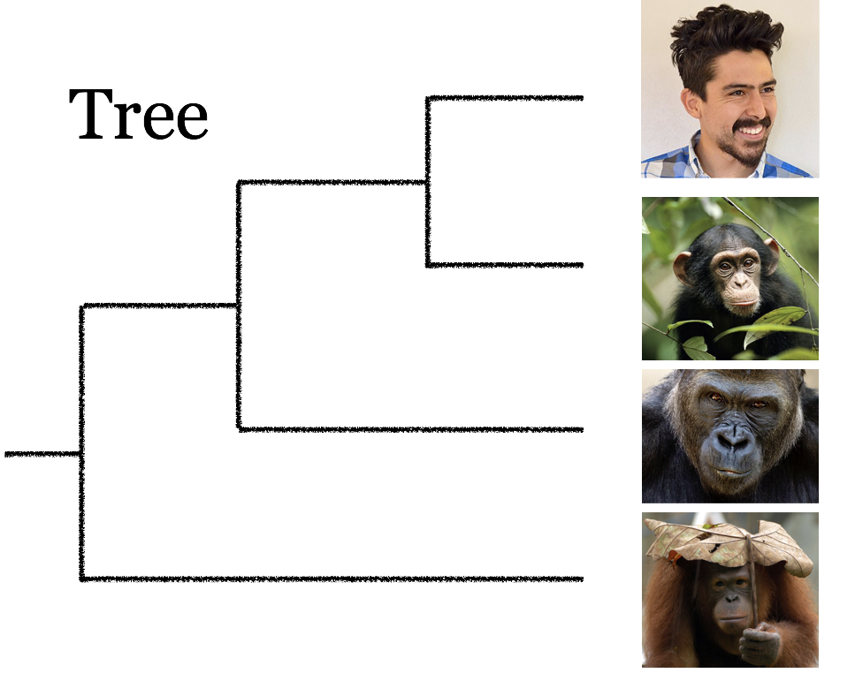
Phylogenetic Tree
Notes:
Why do we care?
Phylogenetics studies evolution, which is depicted as a bifurcating tree. This tree represents the evolutionary history of 4 primates: human, chimpanzee, gorilla and orangutan. Humans and chimpanzees are sister species because they share a common ancestor (represented by the internal node in the tree).

Slide 5


Others
Dentist
AIDS
Motivation
Biology, Linguistics, Forensics
Notes:
Motivation
Biology, Linguistics, Forensics
What is the connection between studying bacteria and phylogenetic trees?

Slide 6
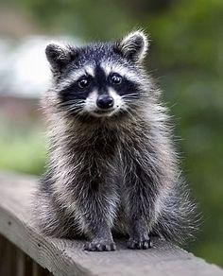
Why is It Difficult?
1 Species = 1 Tree

Slide 7
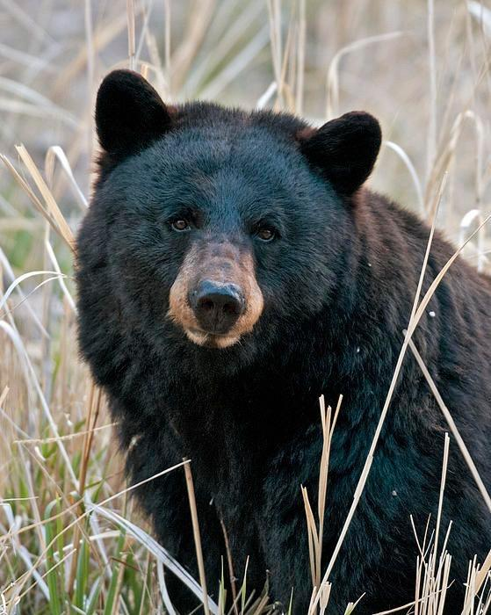
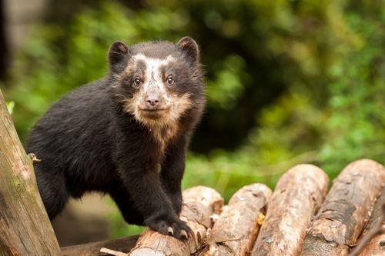
Why is It Difficult?
2 Species = 1 Tree

Slide 8
Why is It Difficult?
3 Species = 3 Trees

Slide 9
Why is It Difficult?
3 Species = 3 Trees

Slide 10
Why is It Difficult?
3 Species = 3 Trees

Slide 11

Why is It Difficult?
4 Species = 15 Trees

Slide 12
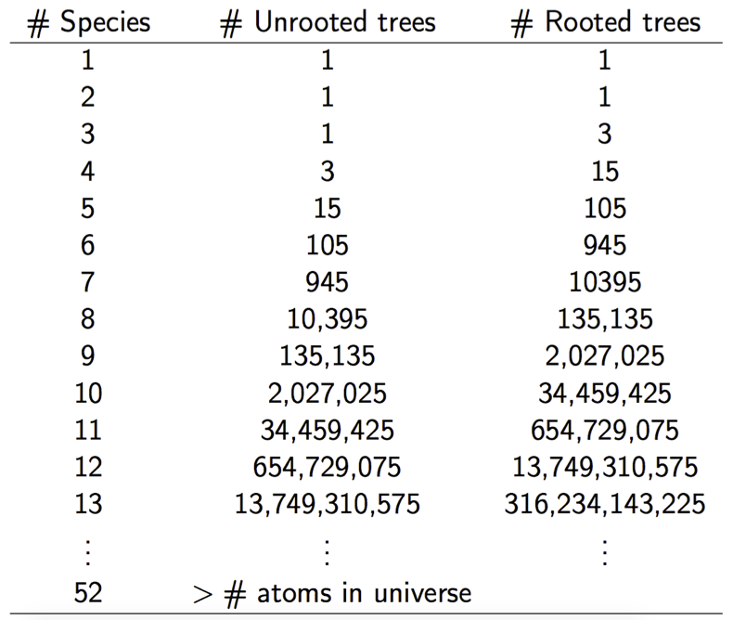
Why is It Difficult?
52 Species = More than Atoms of Universe

Slide 13

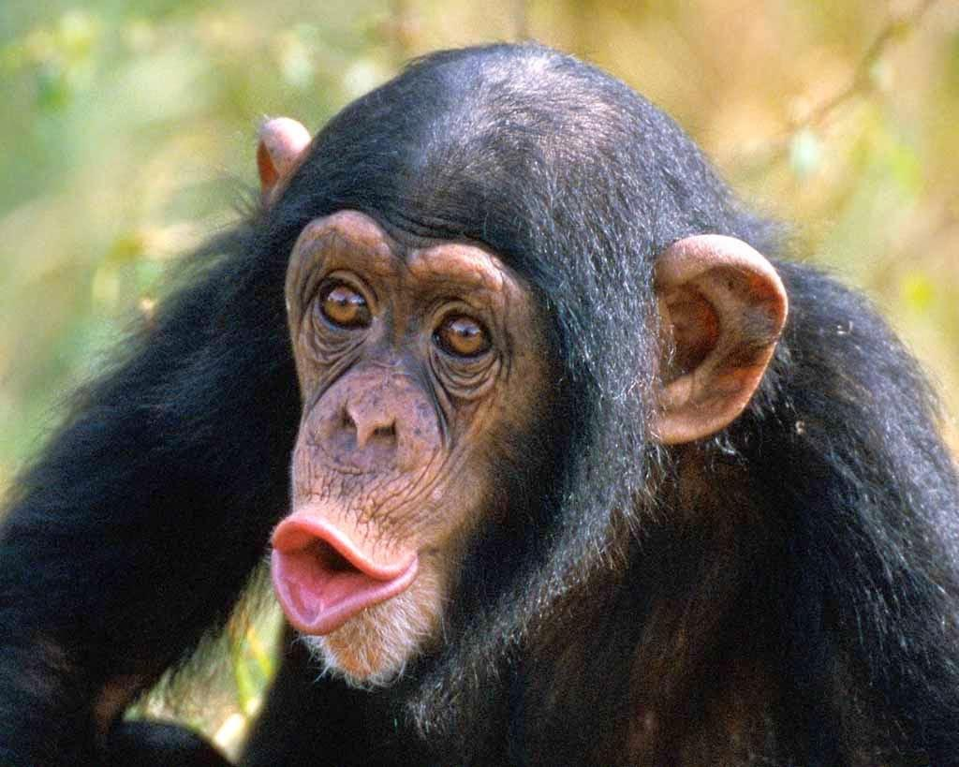
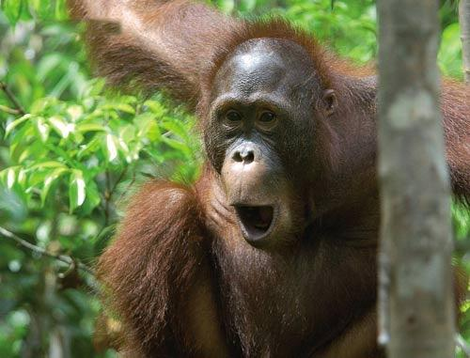
Phylogenetic Tree

Slide 14



Phylogenetic Tree

Slide 15
Phylogenetic Network

Slide 16
Phylogenetic Network

Slide 17
Phylogenetic Network

Slide 18
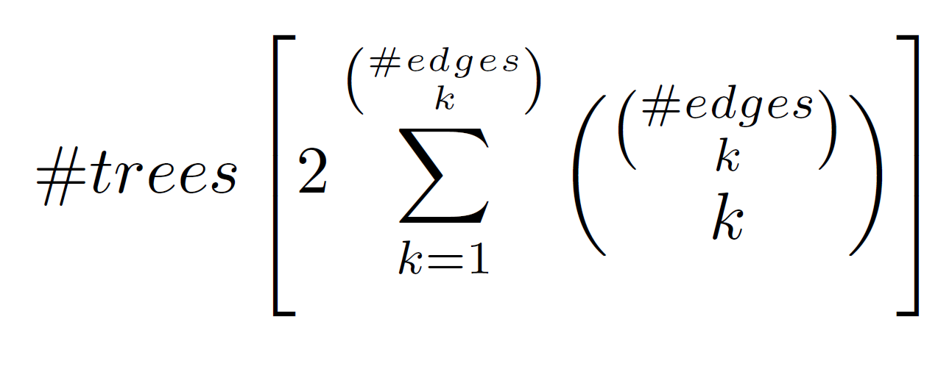
Phylogenetic Networks=
Phylogenetic Network

Slide 19
6
5
4
3
2
1
Time
1 2 3
Number of Species
Exponential Computation Time

Slide 20
15
14
13
12
11
10
9
8
7
6
5
4
3
2
1
Time
1 2 3 4
Number of Species
Exponential Computation Time

Slide 21
days
.
.
24
22
20
18
16
14
12
10
8
6
4
2
Time
1 2 3 4 5
Number of Species
Exponential Computation Time

Slide 22
weeks
.
.
. 1week
.
.
.
.
.
days
20
15
10
5
Time
1 2 3 4 5 6
Number of Species
Exponential Computation Time

Slide 23
1month
.
weeks
.
.
. 1week
.
.
.
days
20
15
10
5
This is the
importance
of our work!
Time
1 2 3 4 5 6 7 8 9 10
Number of Species
Exponential Computation Time

Slide 24

Department of Human Genetics
Emory University
PhD Statistics
Claudia Solis- Lemus

Slide 25
Method of Inquiry
[1] M. Ajtai, J. Komlós, E. Szemerédi, An O(n log n) sorting network, in: Proc. 15th Annu. ACM Symp. on the Theory of Computing (STOC’83), 1983, pp. 1–9.
[2] D. Bryant. Building trees, hunting for trees, and comparing trees: theory and methods in phylogenetic analysis, Ph.D. Thesis, University of Canterbury, Christchurch, New Zealand, 1997.
[3] A.V. Aho, Y. Sagiv, T.G. Szymanski, J.D. Ullman, Inferring a tree from lowest common ancestors with an application to the optimization of relational expressions, SIAM J. Comput. 10 (3) (1981) 405–421.
[4] D. Bryant, V. Moulton, Neighbor-net: an agglomerative method for the construction of phylogenetic networks, Mol. Biol. Evol. 21 (2) (2004) 255–265.
[5] B. Chor, M. Hendy, D. Penny, Analytic solutions for three-taxon MLMC trees with variable rates across sites, in: Proc. of the First Workshop on Algorithms in Bioinformatics (WABI 2001), Lecture Notes in Computer Science, Vol. 2149, Springer, Berlin, 2001, pp. 204–213.
[6] C. Choy, J. Jansson, K. Sadakane, W.-K. Sung, Computing the maximum agreement of phylogenetic networks, Theoret. Comput. Sci. 335 (1) (2005) 93–107.
[7] T. Cormen, C. Leiserson, R. Rivest, Introduction to Algorithms, The MIT Press, MA, 1990.
[8] L. G¸asieniec, J. Jansson, A. Lingas, A. Östlin, Inferring ordered trees from local constraints, in: Proc. of Computing: the Fourth Australasian Theory Symposium (CATS’98), Australian Computer Science Communications, Vol. 20(3), Springer, Singapore, 1998, pp. 67–76.
[9] Jansson, J. and Sung, W. (2018). Inferring a level-1 phylogenetic network from a dense set of rooted triplets. [online] Www-new.comp.nus.edu.sg. Available at: https://wwwnew.comp.nus.edu.sg/~wongls/psZ/apbc2005/camera-ready/173.pdf [Accessed 18 Jan. 2018].

Slide 26
Method of Inquiry
[1] M. Ajtai, J. Komlós, E. Szemerédi, An O(n log n) sorting network, in: Proc. 15th Annu. ACM Symp. on the Theory of Computing (STOC’83), 1983, pp. 1–9.
[2] D. Bryant. Building trees, hunting for trees, and comparing trees: theory and methods in phylogenetic analysis, Ph.D. Thesis, University of Canterbury, Christchurch, New Zealand, 1997.
[3] A.V. Aho, Y. Sagiv, T.G. Szymanski, J.D. Ullman, Inferring a tree from lowest common ancestors with an application to the optimization of relational expressions, SIAM J. Comput. 10 (3) (1981) 405–421.
[4] D. Bryant, V. Moulton, Neighbor-net: an agglomerative method for the construction of phylogenetic networks, Mol. Biol. Evol. 21 (2) (2004) 255–265.
[5] B. Chor, M. Hendy, D. Penny, Analytic solutions for three-taxon MLMC trees with variable rates across sites, in: Proc. of the First Workshop on Algorithms in Bioinformatics (WABI 2001), Lecture Notes in Computer Science, Vol. 2149, Springer, Berlin, 2001, pp. 204–213.
[6] C. Choy, J. Jansson, K. Sadakane, W.-K. Sung, Computing the maximum agreement of phylogenetic networks, Theoret. Comput. Sci. 335 (1) (2005) 93–107.
[7] T. Cormen, C. Leiserson, R. Rivest, Introduction to Algorithms, The MIT Press, MA, 1990.
[8] L. G¸asieniec, J. Jansson, A. Lingas, A. Östlin, Inferring ordered trees from local constraints, in: Proc. of Computing: the Fourth Australasian Theory Symposium (CATS’98), Australian Computer Science Communications, Vol. 20(3), Springer, Singapore, 1998, pp. 67–76.
[9] Jansson, J. and Sung, W. (2018). Inferring a level-1 phylogenetic network from a dense set of rooted triplets. [online] Www-new.comp.nus.edu.sg. Available at: https://wwwnew.comp.nus.edu.sg/~wongls/psZ/apbc2005/camera-ready/173.pdf [Accessed 18 Jan. 2018].
Personally Contacted Authors!

Slide 27
Our Hypothesis:
A Divide and Conquer Strategy
Can speed things up

Slide 28
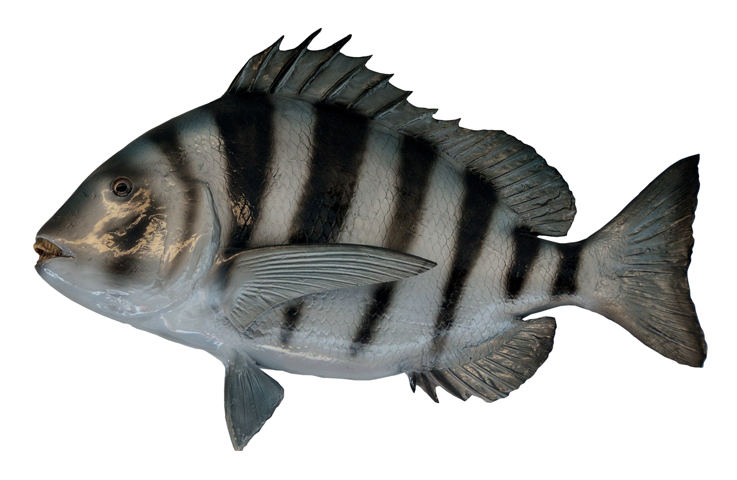

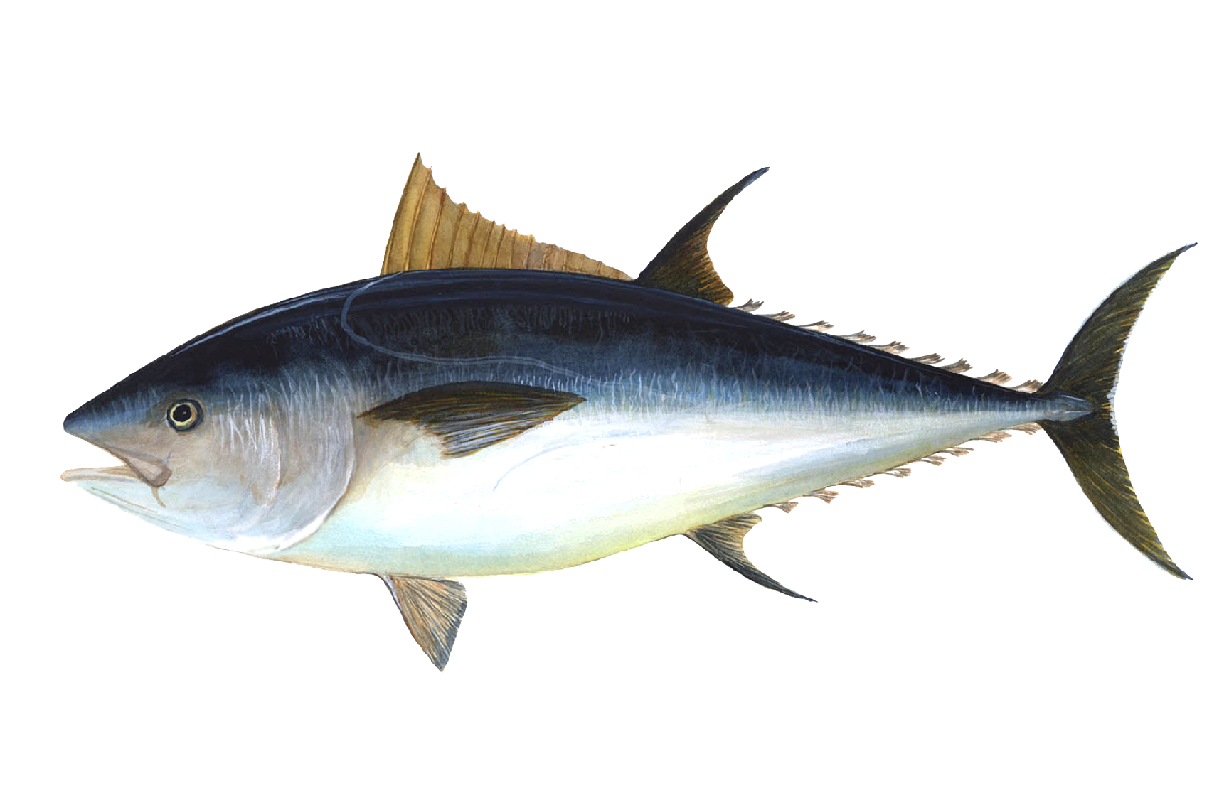


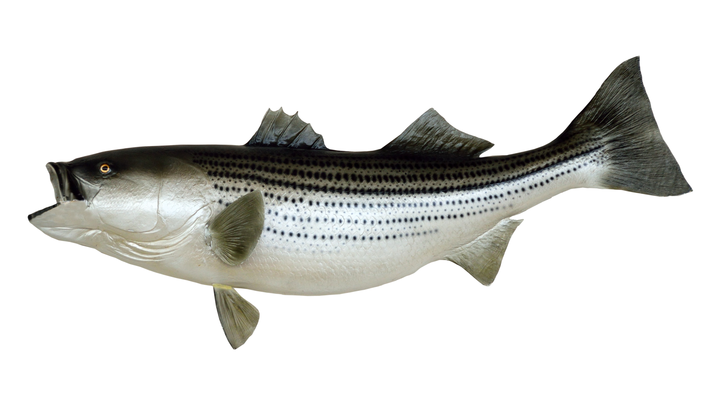
?
Our Strategy
6 Species = 945 Trees and even More Networks

Slide 29
Divide and Conquer
3 Species = 3 Trees

Slide 30
Stitch them Together

Slide 31
Network Inference

Slide 32
LevelOne
ComputeSN
OneHybridLeaf
BuildTree
Algorithm

Slide 33

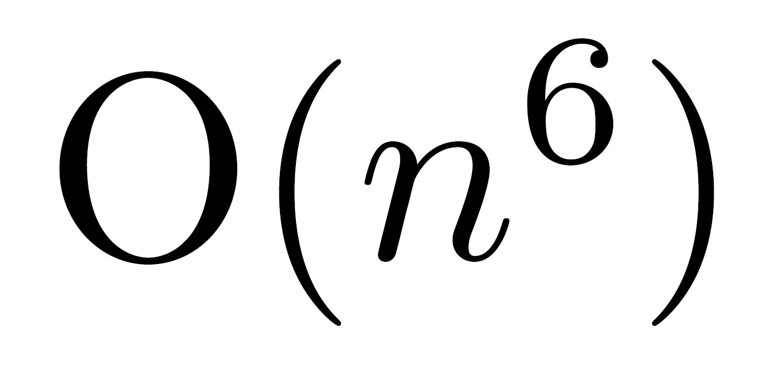
Results
Time
Number of Species
Exponential vs polynomial

Slide 34
Conclusion
Goal: Find Phylogenetic network
Motivation: Biology/ Linguistics/ Forensics
Develop Vaccines/ Drugs
Problem: Exponential Complexity
Inquiry: Asked experts and papers
Hypothesis: Divide and Conquer
Results: Polynomial is better than exponential
Questions?

